Slide 1

Arduino Based counter
Students Name:
Pintu Chakraborty (C.R- 304 U.R- T91/ECE/186003),
Rahul Dey (C.R-325 U.R- T91/ECE/186019),
Nabanita Saha (C.R- 402 U.R- T91/ECE/184047),
Ruchishyo Ghosh (C.R- 405 U.R- T91/ECE/184049),
Shambo Roy (C.R- 432 U.R- T91/ECE/184061).
Under the guidance of : Dr. Anjan Kumar Kundu.

Slide 2
Introduction
Conclusion
Reference
Limitations
Software Simulation
Project Methodology

Slide 3
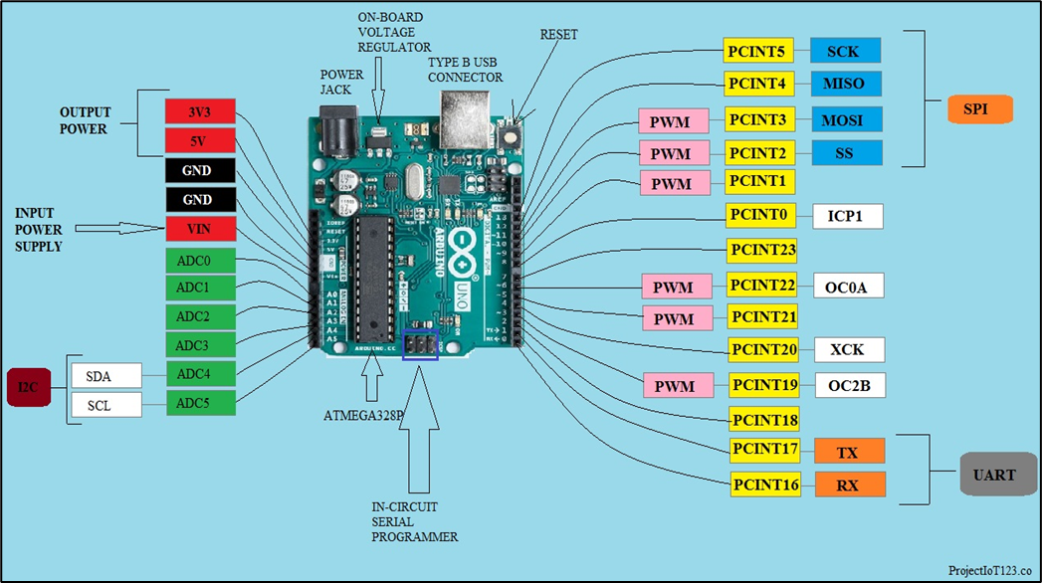
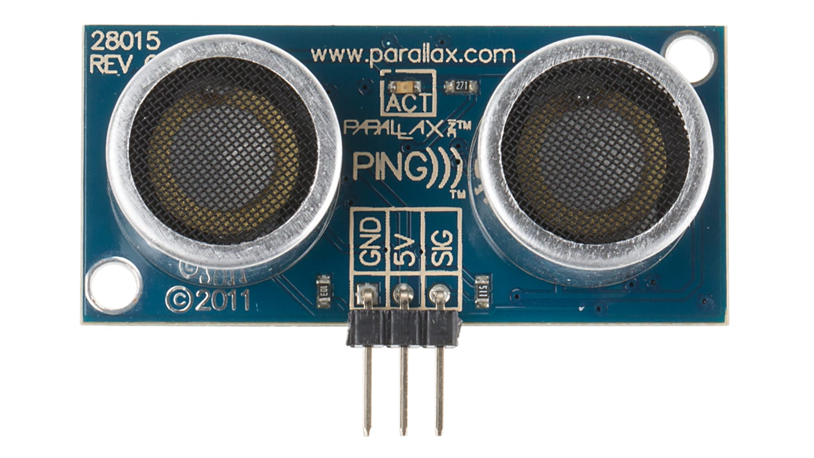
introduction
Aim of the project
Description of Arduino UNO
Advantages and Types
Communication Protocol
Brief details about Pins
Ultrasonic Sensor
Working principle
Types and difference

Slide 4
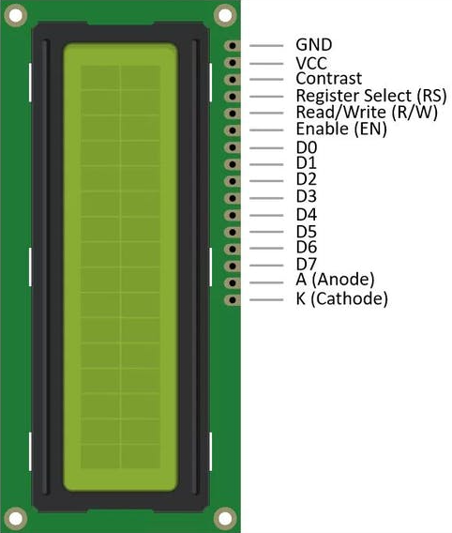
introduction
LCD Module
Types and Pin details
Features
Other Components

Slide 5
Project methodology
The operation is based on the sensors which are placed on the top frame of the door, one on the outside and the other on the inside. The process of detection and execution is depicted in terms of steps,
When a person enter (with minimum height) the sensor detects and provide digital output 1 otherwise it returns 0.
So for data [1,0] and [0,1], with a sequence of [Outside sensor(o/p), Inside sensor(o/p)] we can conclude of an entrance; vice-versa for exit we obtain data [0,1] and [1,0].
We have used a variable state to get rid of the program complexity, defined by the table given.
STATE | CONDITION
0 | No movement
31 | Entry
13 | Exit

Slide 6
Project methodology
As a result, after a complete cycle the total count is shown on the LCD monitor. Also it shows the Maximum Capacity for overflow condition.
For our convenience we have assumed that [0,0] and [1,1] output from the sensors makes no change to the count or the state.
The required Flow-Chart is given on the next slide.

Slide 7
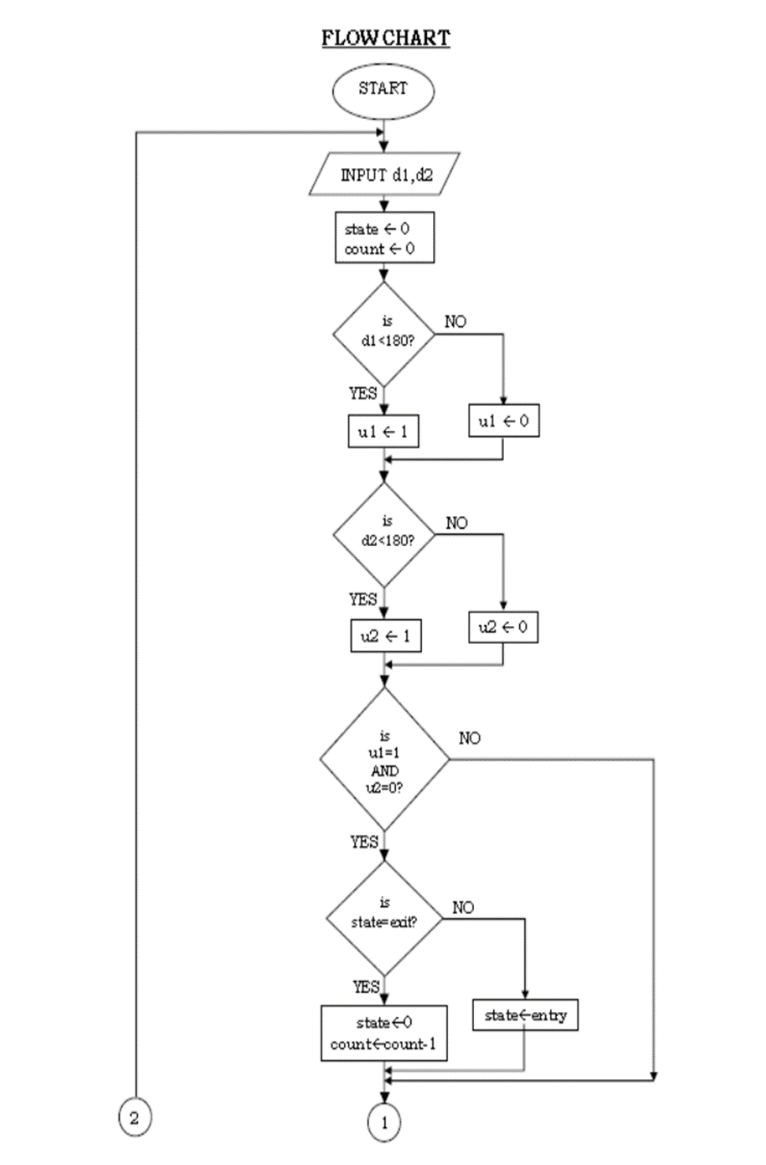
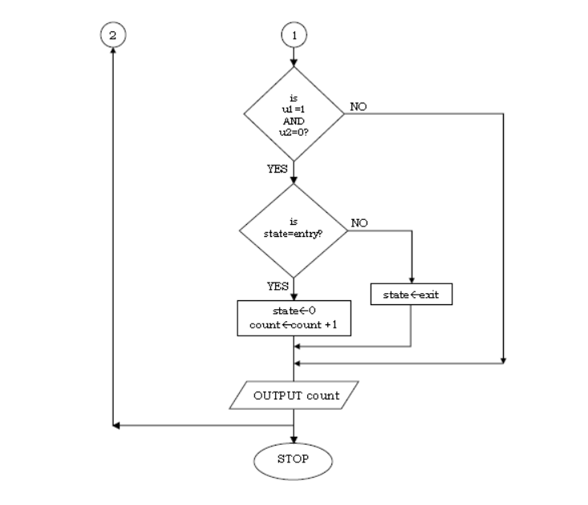

Slide 8
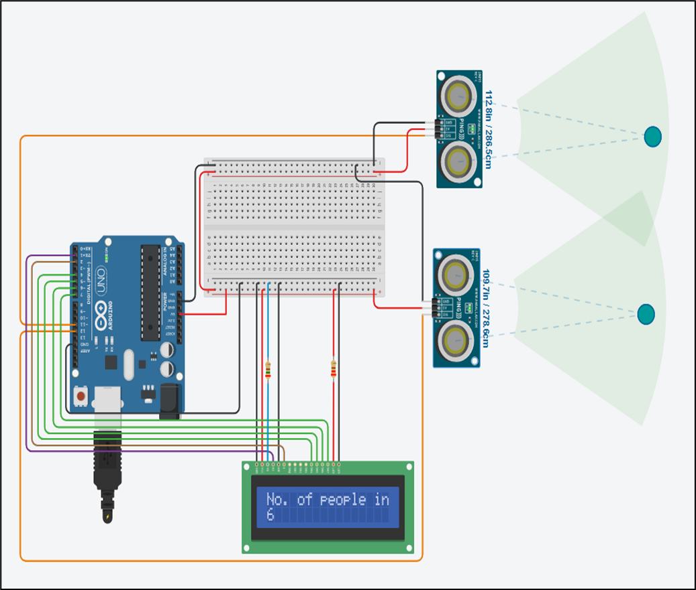
Software simulation
The project has been simulated using a free online computer-aided design(CAD) programmed website, named Tinkercad and the compilation of the code is done in Arduino IDE.

Slide 9
limitations
Person detection with height consideration.
Assumption of generalized walking speed and implementation using delay function.
Assumption of properly separated sensors with no spectrum interference.
Deviation in speed of sound with the change in temperature and humidity. The formula for correction
Speed of sound (m/s) = 331.4 + 0.606*temperature(in ºC) + 0.0124*humidity
Prevention of Dead Zone with the help of door frame.

Slide 10
conclusion
Here we have done only the simulation part due to pandemic situation so we can state that it is an ideal one. Since we have mentioned practical limitations as much as possible so we are much confident about the sustainability of the hardware implementation with respect real life challenges.

Slide 11
references
IoT and it’s Applications by Prof. Satish Jain, Shashi Singh.
https://www.arduino.cc/en/Reference/PulseIn
https://www.tinkercad.com/
https://www.arduino.cc/en/software
Sensors and Transducers by Ian R. Sinclair.
Programming Arduino Getting Started with Sketches by Simon Monk.

